Slide 1


5005CEM Lecture 3a: Summary Statistics of One Variable
School of Computing, Mathematics and Data Science Coventry University
5005CEM Data Science 2022/23 Semester 2

Slide 2
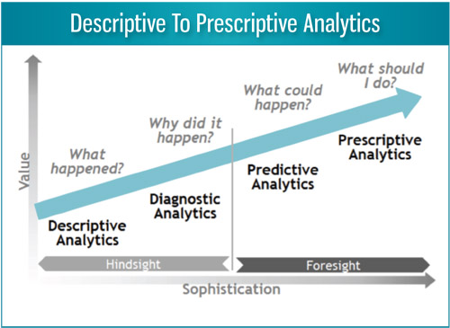
Recap
Exploratory Data Analysis (EDA) — detective work
Summarise the main characteristics of a dataset.
Aim to discover patterns and propose hypotheses/models.
Ask the question: “What is going on here?”
Descriptive Analytics — what happened?
looking back to the past (“hindsight”)
Notes:
Analytics definition from INFORMS

Slide 3
Rectangular Data
Data in rows and columns (like a database).
A row in the data table corresponds to a case (record, example, instance, observation).
A column in the data table corresponds to a variable (feature, attribute, input, predictor).
Categorical variable (names or labels), e.g., favourite ice cream flavour.
Quantitative variable (numerical values with magnitude), e.g., time to run 100 metres.
Notes:
Reading: https://online.stat.psu.edu/stat200/lesson/1/1.1

Slide 4
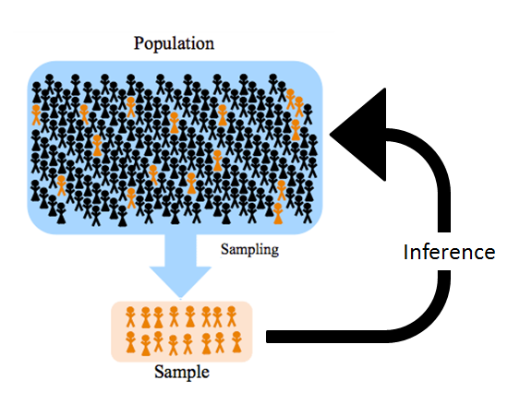
Populations and Samples
Population: the entire set of possible cases.
Sample: a subset of the population from which data are collected.
Parameter: a measure concerning a population, e.g., population mean.
Statistic: a measure concerning a sample, e.g., sample mean.
Notes:
Reading: https://online.stat.psu.edu/stat200/lesson/2

Slide 5
Describing Data
Describe (summarise) dataset with numbers and graphs/plots.
Univariate data (one variable)
One categorical variable
One quantitative variable
Bivariate data (two variables)
Two categorical variables
Two quantitative variables
One categorical variable and one quantitative variable
Multivariate data (more than two variables)

Slide 6
Summary of One Categorical Variable
Data: list of individuals and which country they live in
Summary: frequency table gives a count for each category
Mode is the category with the highest frequency
Country | Population (estimate mid-2018)
England | 55977178
Scotland | 5438100
Wales | 3138631
Northern Ireland | 1881641

Slide 7
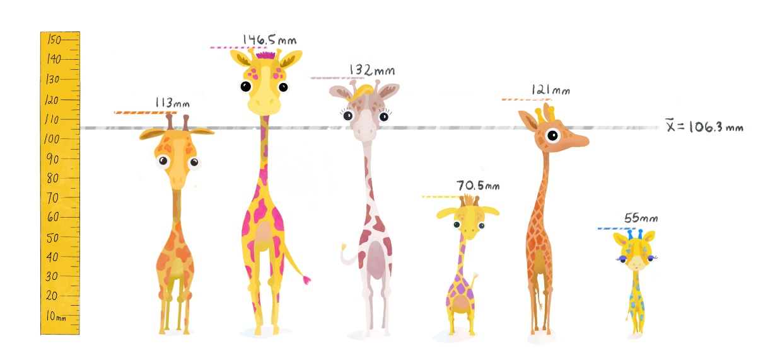
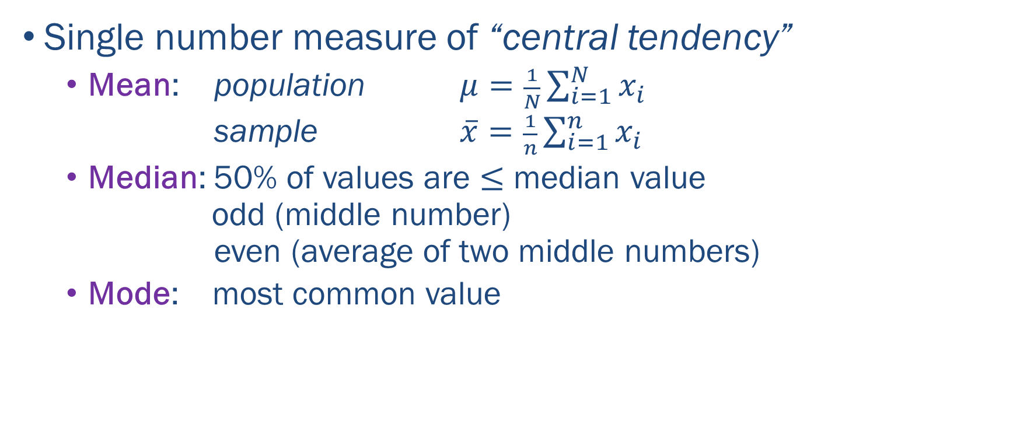
Summary Statistics of One Quantitative Variable
Single number measure of “central tendency”
Mean: population $μ=\frac{1}{N}\sum_{i=1}^{N}{x_{i}}$
sample $\overline{x}=\frac{1}{n}\sum_{i=1}^{n}{x_{i}}$
Median: 50% of values are $≤$ median value odd (middle number) even (average of two middle numbers)
Mode: most common value
Notes:
Image from: https://tinystats.github.io/teacups-giraffes-and-statistics/04_variance.html

Slide 8
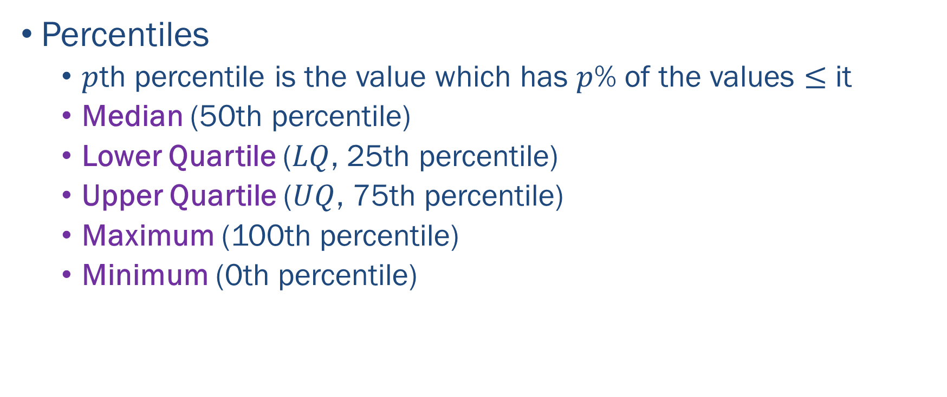
Summary Statistics of One Quantitative Variable
Percentiles
$p$th percentile is the value which has $p$% of the values $≤$ it
Median (50th percentile)
Lower Quartile ($LQ$, 25th percentile)
Upper Quartile ($UQ$, 75th percentile)
Maximum (100th percentile)
Minimum (0th percentile)
Notes:
Boxplot image from: https://faculty.elgin.edu/dkernler/statistics/ch03/3-5.html

Slide 9
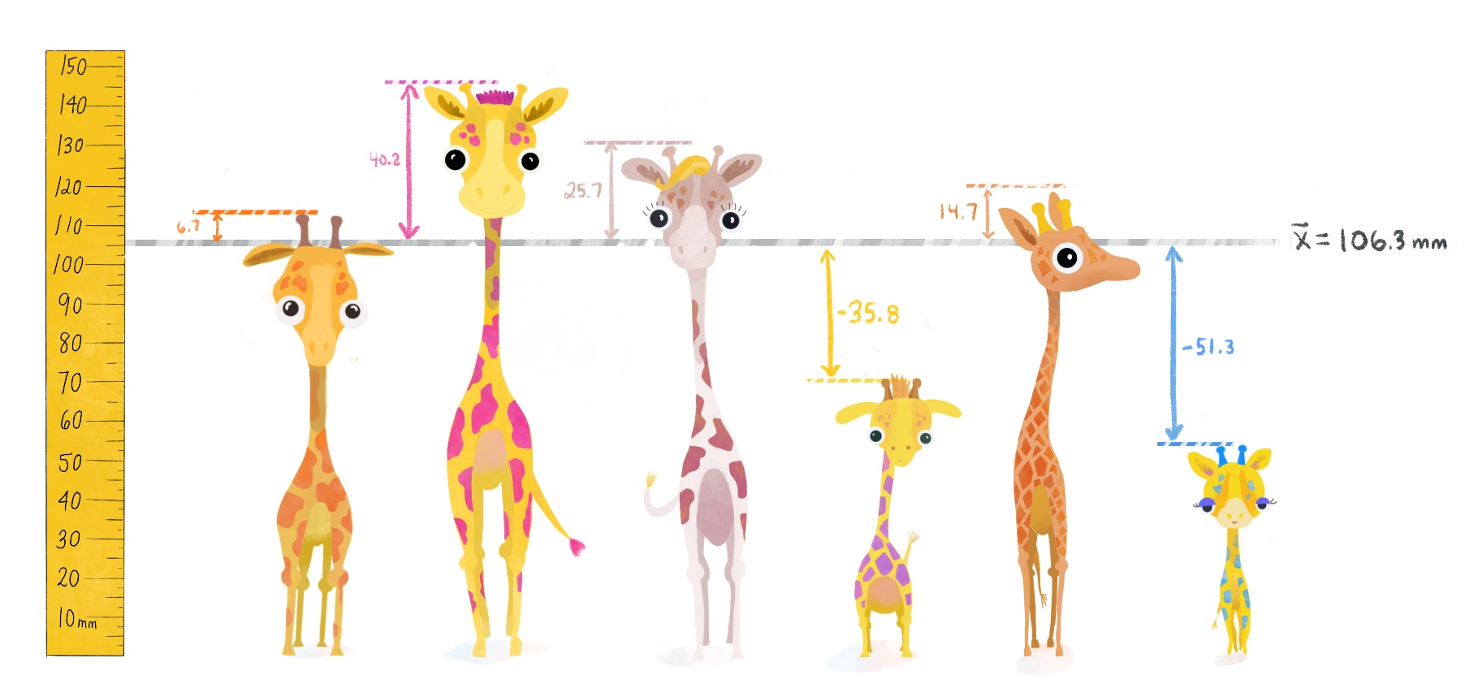
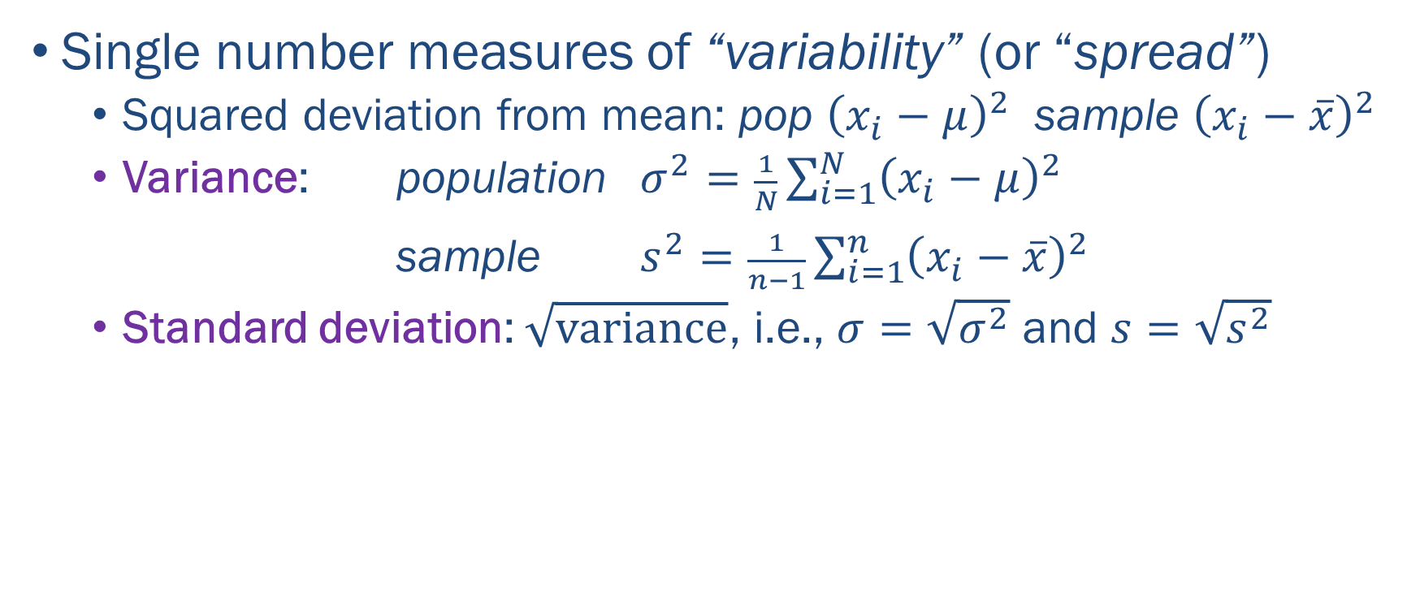
Summary Statistics of One Quantitative Variable
Single number measures of “variability” (or “spread”)
Squared deviation from mean: pop ${\left(x_{i}−μ\right)}^{2}$ sample ${\left(x_{i}−\overline{x}\right)}^{2}$
Variance: population $σ^{2}=\frac{1}{N}\sum_{i=1}^{N}{{\left(x_{i}−μ\right)}^{2}}$ sample $s^{2}=\frac{1}{n−1}\sum_{i=1}^{n}{{\left(x_{i}−\overline{x}\right)}^{2}}$
Standard deviation: $\sqrt{\text{variance}}$, i.e., $σ=\sqrt{σ^{2}}$ and $s=\sqrt{s^{2}}$

Slide 10
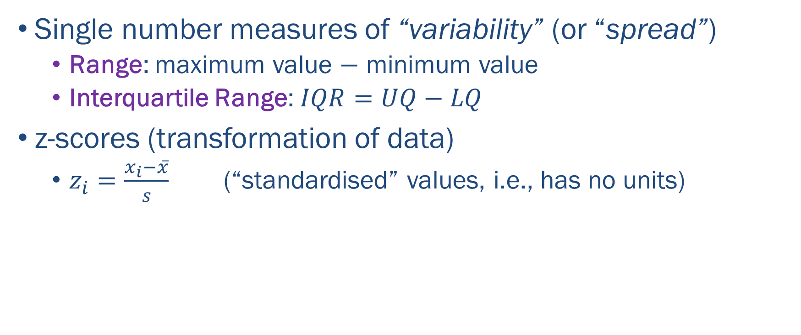
Summary Statistics of One Quantitative Variable
Single number measures of “variability” (or “spread”)
Range: maximum value $−$ minimum value
Interquartile Range: $IQR=UQ−LQ$
z-scores (transformation of data)
$z_{i}=\frac{x_{i}−\overline{x}}{s}$ (“standardised” values, i.e., has no units)

Slide 11
Summary Statistics of One Quantitative Variable
What makes for a good measure?
Mean, range, variance and standard deviation are sensitive to extreme values (outliers), e.g., house prices.
Often want measures that are more robust, i.e., not sensitive to extreme values.
Other measure (median, trimmed mean, percentiles, IQR) are more robust.
However, mean and variance have amazing mathematical properties useful, e.g., in statistical inference.

Slide 12
Summary
Vital to classify variables as:
categorical (names or labels); or
quantitative (numerical values with magnitude)
Summarise a categorical variable by counts for each category.
Summarise a quantitative variable by:
central tendency: mean, median, mode
variability: range, interquartile range, variance, standard deviation, percentiles

Slide 13
Class Discussion Questions
Give two purposes (or reasons) for applying Exploratory Data Analysis (EDA) to a dataset.
Describe two dangers of summarising a dataset with summary statistics.
What summary statistics would you recommend for one categorical variable?
What summary statistics would you recommend for one quantitative variable?

Slide 14
Class Discussion Questions
Consider the two quotes below and discuss whether or not they are relevant to EDA.
“Facts are stubborn things, but statistics are pliable.” — Mark Twain
“Data is like garbage. You'd better know what you are going to do with it before you collect it.” — Mark Twain

